Slide 1
DEVOPS ENGINEERING

Slide 2
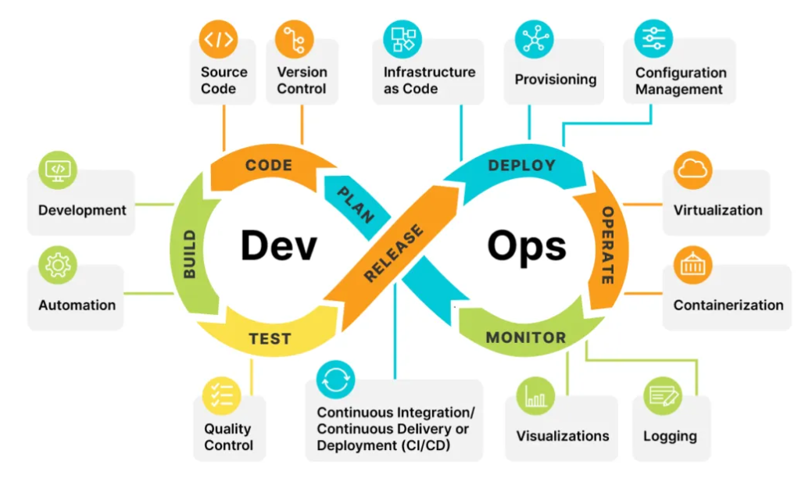

Slide 3
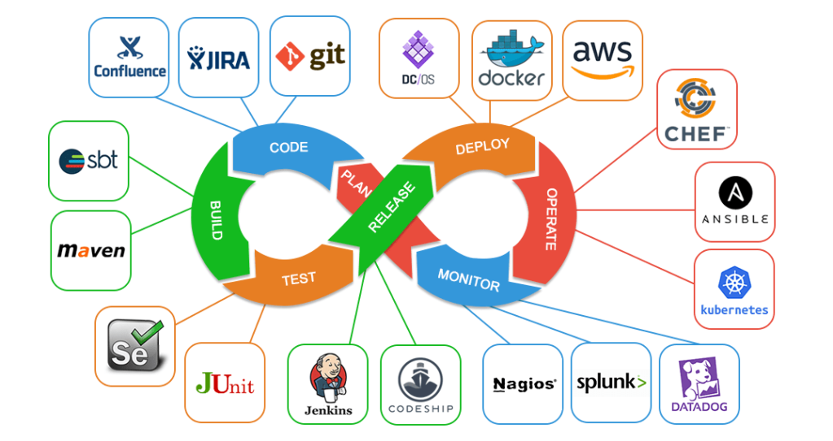

Slide 4
DEVOPS---DOCKER

Slide 5
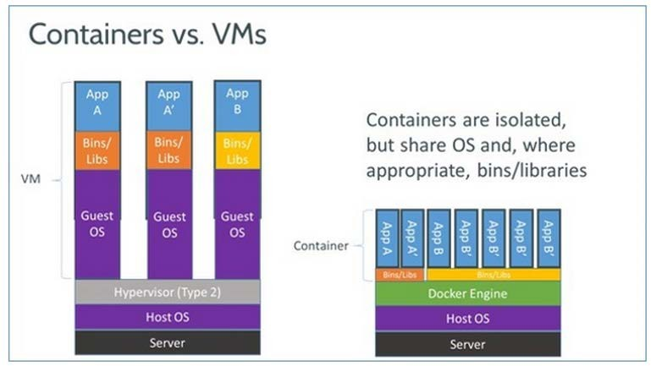
Docker containers

Slide 6
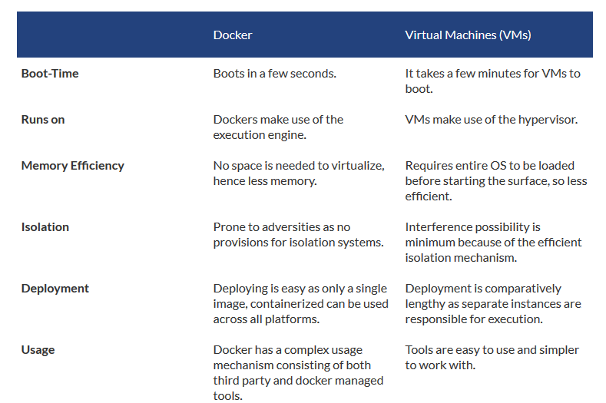

Slide 7
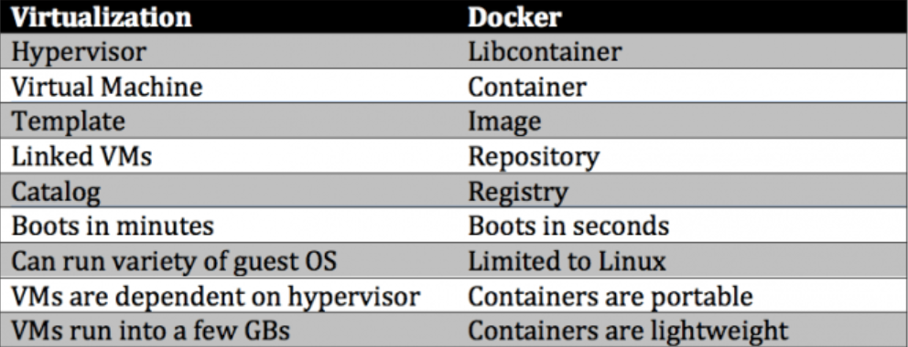

Slide 8
Docker
Docker is a very light-weight software container and containerization platform
Docker containers provide a way to run software in isolation
What does a Docker Container contain and provide?
  Initially – only a base Linux operating system
  A boundary or a “jail” to contain running software
  Like a good jail, there are no unauthorized entries or exits
  A Docker Image is the foundation for any particular Docker container
What is outside of Docker?
  Other Docker containers
  The operating system, kernel
  Any other operating software

Slide 9
Docker
Docker is computer software used for Virtualization in order to have multiple Operating systems running on the same host. Unlike Hypervisors which are used for creating VM (Virtual machines), virtualization in Docker is performed on system-level in so-called Docker containers.
Docker containers run on top of the host's Operation system. This helps you to improves efficiency. Moreover, we can run more containers on the same infrastructure than we can run Virtual machines because containers use fewer resources.

Slide 10
Docker was originally a Linux application
Docker for Linux
It uses the kernel container functionality
It requires a 64 bit installation using a
kernel version 3.10 or later
Docker runs on many popular Linux distributions
It is available as RPM, APT, or binary
versions

Slide 11
Docker runs natively on OS X
Docker for OS X
DMG install application running in user space
Is built on the xhyve hypervisor
Requires a 2010 or newer Mac with Intel MMU and
EPT support
Requires OS X 10.10.3 Yosemite or newer
Requires at least 4GB of RAM

Slide 12
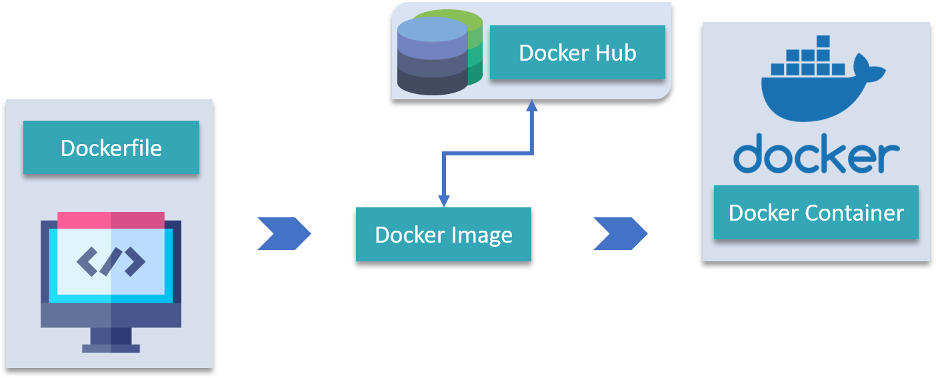

Slide 13
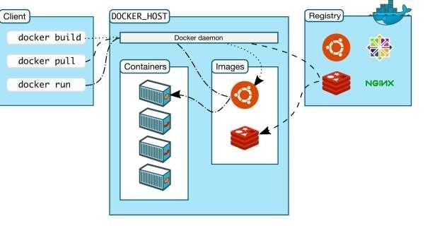
Docker Architecture
Docker uses a client-server architecture
Client
  Is the primary user interface which
communicates using a REST API
  Over HTTP
  Over local Unix socket
•
Server
Is the Docker daemon
Responsible for building, running, and distributing containers
Registry
  Responsible for the storage, management, and delivery of Docker Images
    Docker Hub
    Private
    Other vendors

Slide 14
Running Containers
The docker `run` command starts a container based on a named Docker Image
  Docker first looks for a local copy of the image
o If it does not exist it is pulled from a Docker Registry
o The default Registry is the Docker Hub Registry
  A new container is created using the file system from the image
  A read-write layer is added to the top of the file system
  A network interface is created and an IP address is assigned from a pool
  Standard input, output, and error streams are connected
  A specified application is executed
o Docker container appears as a child of the daemon process, ms are connected

Slide 15
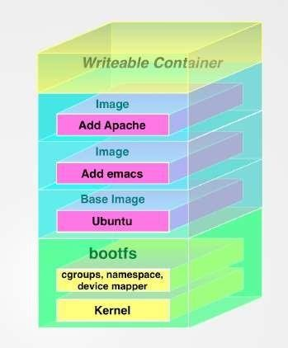
Docker Images & Containers
Docker images are read-only templates
  Foundation is a simplified version of the Linux operating system
  Changes to foundation, such as application installations
added to the Image
  Images are the templates or build commands for Docker
Docker containers are running environments
  Has OS, environment, program, network, etc.
  Runs (probably one) application
  All required software contained in image
  Can have boot-up configuration
  They can be run, started, stopped, and deleted

Slide 16
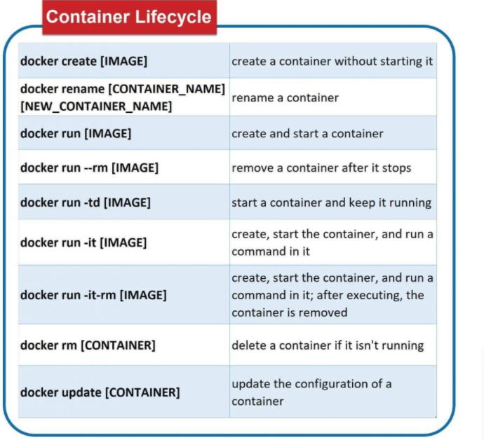

Slide 17
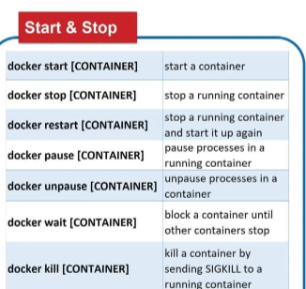

Slide 18
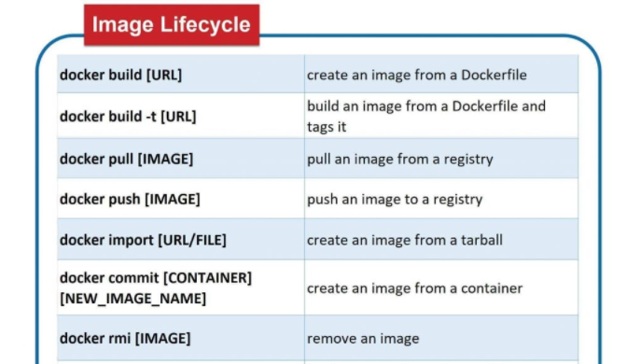

Slide 19
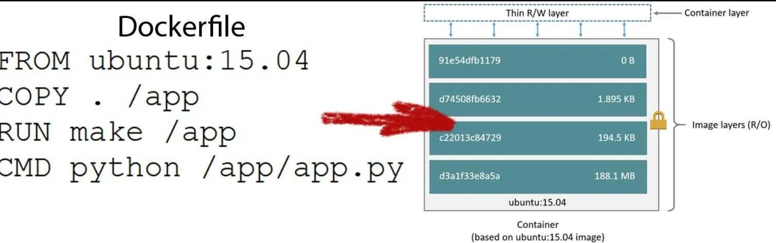

Slide 20
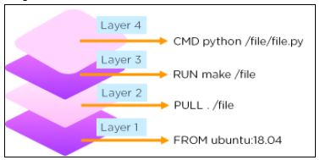

Slide 21
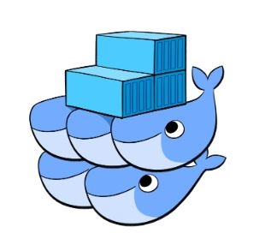
Docker Swarm
Docker Swarm is an orchestration management tool that runs on Docker applications. It helps end-users in creating and deploying a cluster of Docker nodes.
Each node of a Docker Swarm is a Docker daemon, and all Docker daemons interact using the Docker API. Each container within the Swarm can be deployed and accessed by nodes of the same cluster.

Slide 22
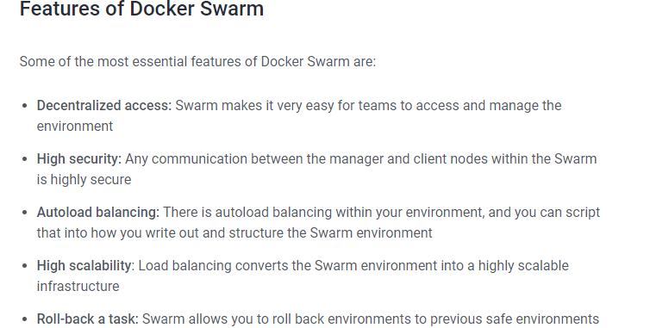

Slide 23
What is a data serialization language?
A language used to convert or represent structured data or objects as a series of characters that can be stored on a disk.
Examples:
  CSV – Comma separated values
  XML – Extensible markup language
  JSON – JavaScript object notation
  YAML – YAML ain’t markup language

Slide 24
What is YAML?
YAML includes a markup language with important construct, to distinguish data-oriented language with the document markup. The design goals and features of YAML are given below −
Matches native data structures of agile methodology and its languages such as Perl, Python, PHP, Ruby and JavaScript
YAML data is portable between programming languages
Includes data consistent data model
Easily readable by humans
Supports one-direction processing

Slide 25
Why YAML if XML?
Unlike XML which is not easily readable by humans, YAML was created to be human-friendly and integrate easily with modern programming languages.
Unlike with XML, YAML was intended to simplify the viewing and understanding of config files, log files, object persistence, and messaging, to allow the programmer to spend more time programming and less time formatting data.
JSON is only readable whereas YAML can be readable as well as editable. JSON is a subset of YAML so that YAML parsers can be able to parse JSON. YAML doesn't use any extra delimiters, so it is more light-weight than XML and JSON.

Slide 26
YAML Design Goals
As stated in the YAML official specification, the design
goals for YAML in decreasing priority are:
  YAML is easily readable by humans
  YAML data is portable between programming languages
  YAML matches the native data structures of agile languages.
  YAML has a consistent model to support generic tools.
  YAML supports one-pass processing.
  YAML is expressive and extensible.
  YAML is easy to implement and use.

Slide 27
